Slide 1
Customer Feedback Management System
SQL Project

Slide 2
Introduction
In MySQL is a software application designed to collect, store, analyze, and manage customer feedback. This system provides businesses with valuable insights into customer satisfaction, enabling them to improve products, services, and overall customer experience.

Slide 3
Objectives
Simplify the process of collecting feedback.
Provide structured storage and retrieval using MySQL.
Generate actionable insights from customer data.
Enable administrators to address customer concerns effectively.

Slide 4
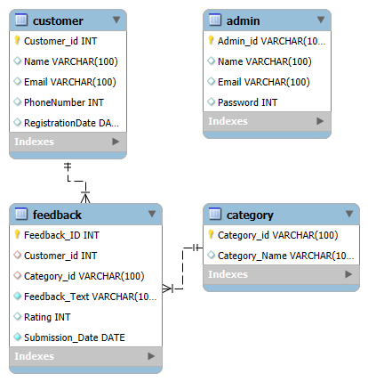
Tables

Slide 5
Entities and Attributes
Customer
Customer_id (Primary Key): Unique identifier for each customer.
Name: Full name of the customer.
Email: Customer's email address.
PhoneNumber: Phone number of the customer.
RegistrationDate: Timestamp when the customer was added to the system.
Category
Category_id (Primary Key): Unique identifier for each category.
Category_Name: Name of the feedback category.

Slide 6
Admin
Admin_id (Primary Key): Unique identifier for each admin.
Name: Full name of the admin.
Email: Admin's email address.
Password: Encrypted password for login.
Feedback
Feedback_id (Primary Key): Unique identifier for each feedback entry.
Customer_id (Foreign Key): References customer_id in the Customer table.
Category_id (Foreign Key): References category_id in the Category table.
Feedback_text: Detailed description of the feedback.
Rating : Numeric rating given by the customer.
Submission_Date: Date and time when the feedback was submitted.

Slide 7
Query
Find Feedback Submitted within a Specific Date Range.
List Most Recent Feedback ,Get the 5 most recent feedback entries.
Retrieve Positive Feedback .
Fetch Feedback Submitted in the Last 7 Days.
Retrieve All Feedback for a Specific Category.

Slide 8
Conclusion
Successfully implemented core functionalities like feedback submission, categorization, and admin management.
Designed a structured and scalable MySQL database to store feedback data securely.Enhanced efficiency in handling customer feedback and generating actionable insights.

